Slide 1
kNN, LVQ, SOM

Slide 2
Instance Based Learning
K-Nearest Neighbor Algorithm
(LVQ) Learning Vector Quantization
(SOM) Self Organizing Maps

Slide 3
Instance based learning
Approximating real valued or discrete-valued target functions
Learning in this algorithm consists of storing the presented training data
When a new query instance is encountered, a set of similar related instances is retrieved from memory and used to classify the new query instance

Slide 4
Construct only local approximation to the target function that applies in the neighborhood of the new query instance
Never construct an approximation designed to perform well over the entire instance space
Instance-based methods can use vector or symbolic representation
Appropriate definition of „neighboring“ instances

Slide 5
Disadvantage of instance-based methods is that the costs of classifying new instances can be high
Nearly all computation takes place at classification time rather than learning time

Slide 6
K-Nearest Neighbor algorithm
Most basic instance-based method
Data are represented in a vector space
Supervised learning
https://people.revoledu.com/kardi/tutorial/KNN/KNN_Numerical-example.html

Slide 7
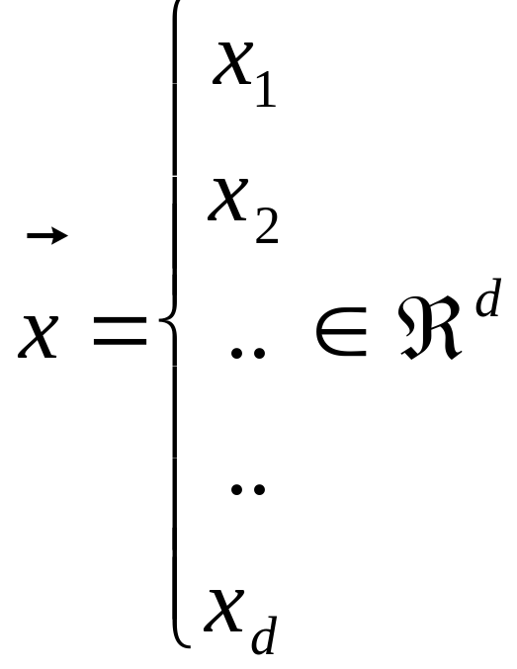
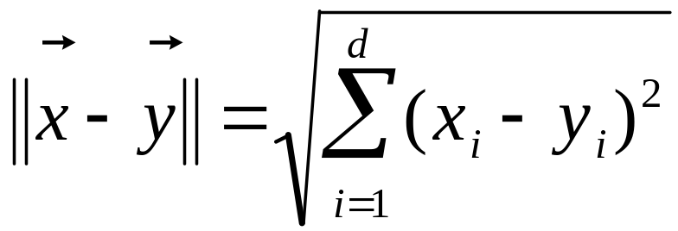
Feature space

Slide 8
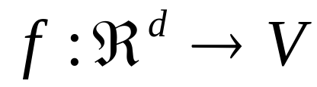
In nearest-neighbor learning the target function may be either discrete-valued or real valued
Learning a discrete valued function
, V is the finite set {v₁,......,v_{n}}
For discrete-valued, the k-NN returns the most common value among the k training examples nearest to xq.

Slide 9
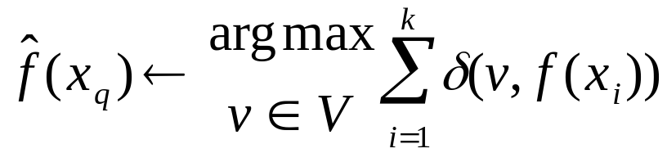
Training algorithm
  For each training example <x,f(x)> add the example to the list
Classification algorithm
  Given a query instance x_{q} to be classified
    Let x₁,..,x_{k} k instances which are nearest to x_{q}
    Where δ(a,b)=1 if a=b, else δ(a,b)= 0 (Kronecker function)

Slide 10
Definition of Voronoi diagram
the decision surface induced by 1-NN for a typical set of training examples.
_
.
_
_
.
+
_
.
+
.
.
_
xq
+
_
.
+

Slide 11


Slide 12
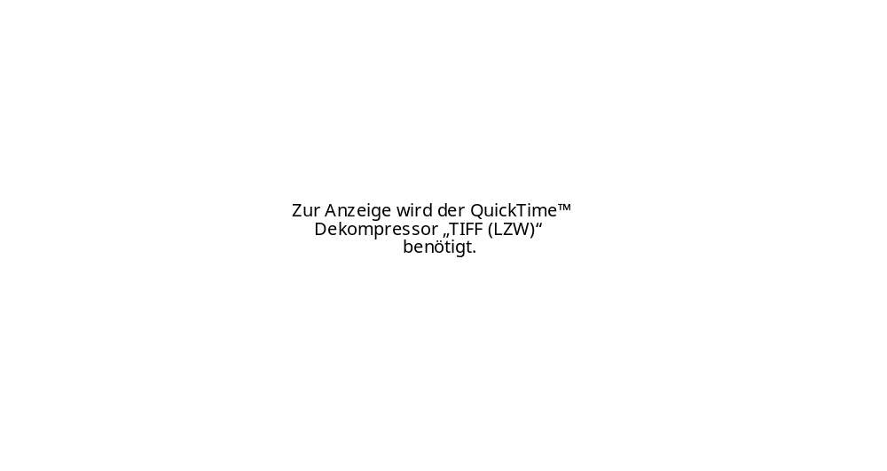
kNN rule leeds to partition of the space into cells (Vornoi cells) enclosing the training points labelled as belonging to the same class
The decision boundary in a Vornoi tessellation of the feature space resembles the surface of a crystall

Slide 13
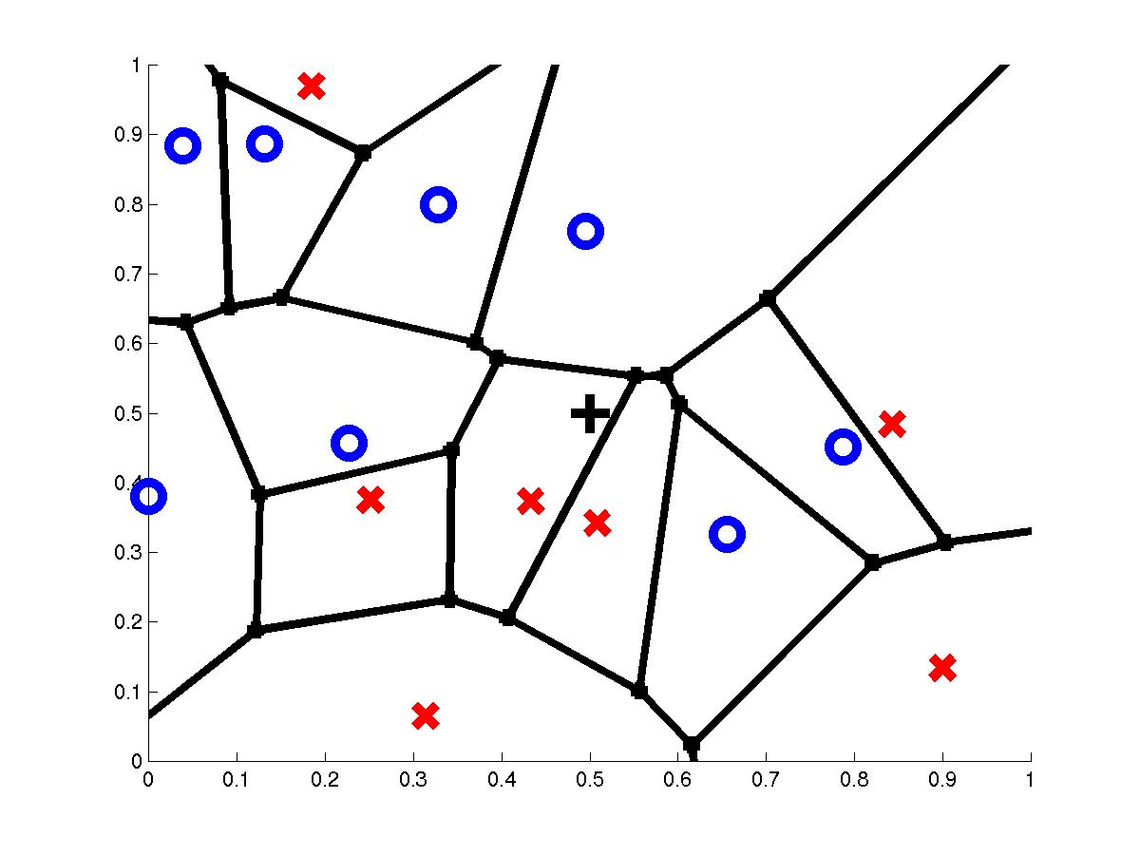
1-Nearest Neighbor
query point q_{f}
nearest neighbor q_{i}

Slide 14
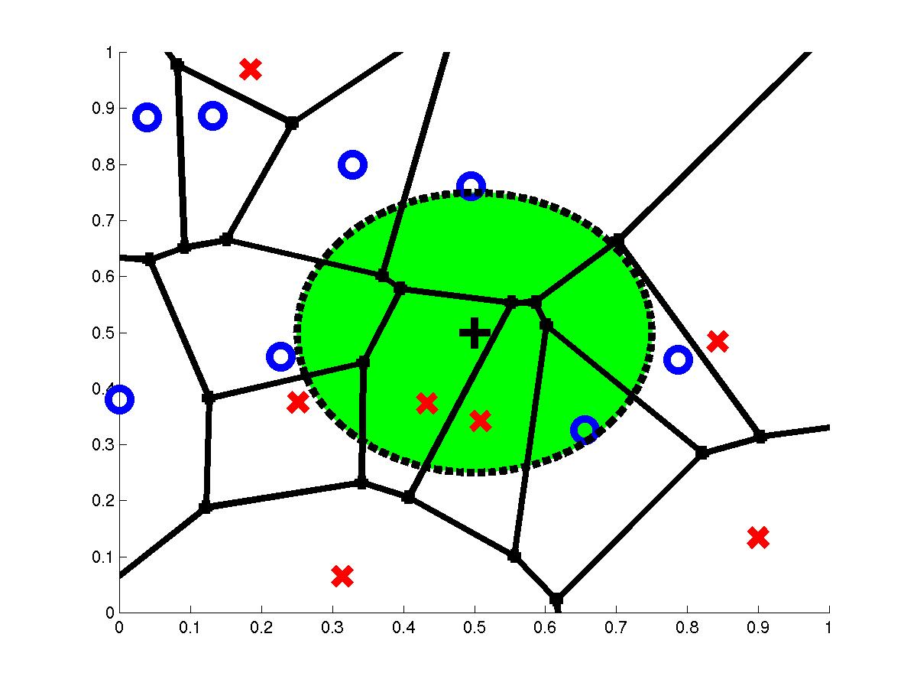
3-Nearest Neighbors
query point q_{f}
3 nearest neighbors
2x,1o

Slide 15
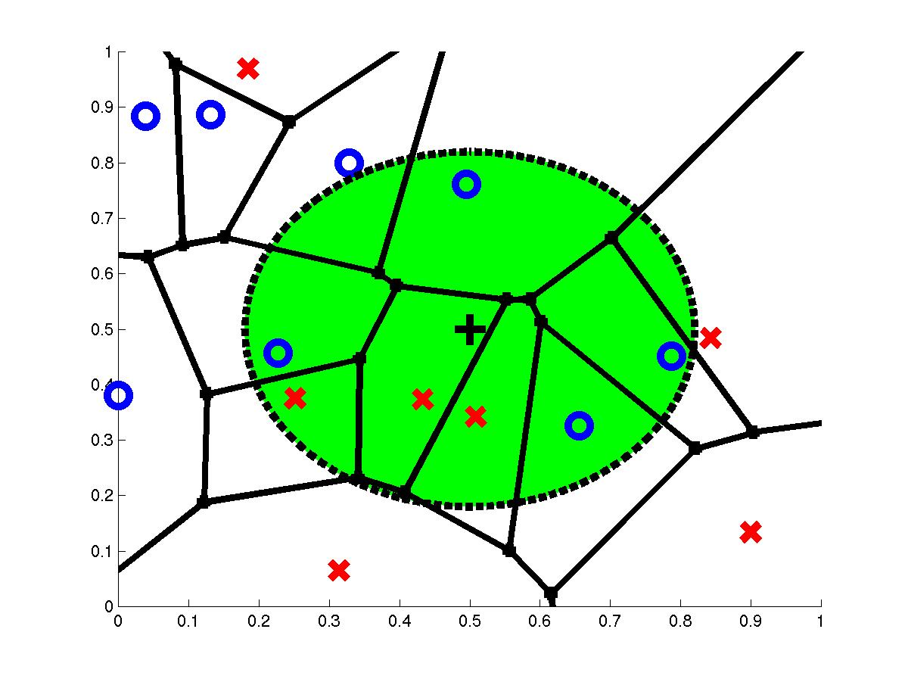
7-Nearest Neighbors
query point q_{f}
7 nearest neighbors
3x,4o

Slide 16
How to determine the good value for k?
Determined experimentally
Start with k=1 and use a test set to validate the error rate of the classifier
Repeat with k=k+2
Choose the value of k for which the error rate is minimum
Note: k should be odd number to avoid ties

Slide 17
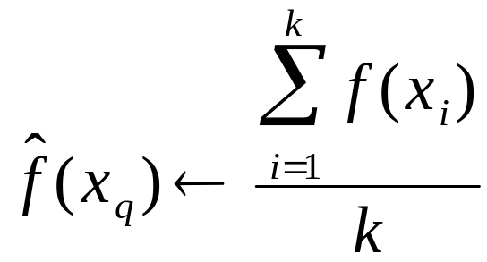
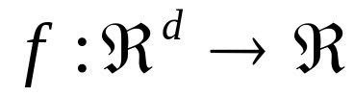
Continous-valued target functions
kNN approximating continous-valued target functions
Calculate the mean value of the k nearest training examples rather than calculate their most common value

Slide 18
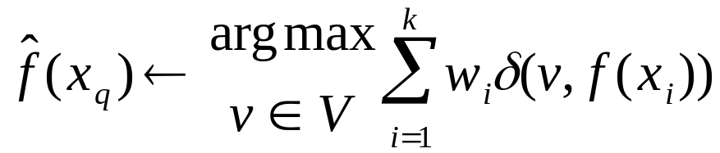
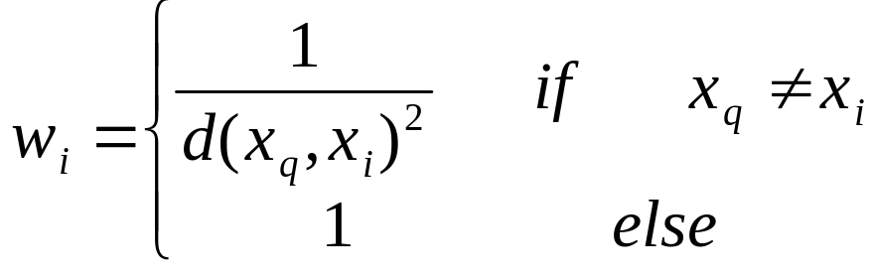
Distance Weighted
Refinement to kNN is to weight the contribution of each k neighbor according to the distance to the query point x_{q}
  Greater weight to closer neighbors
  For discrete target functions

Slide 19
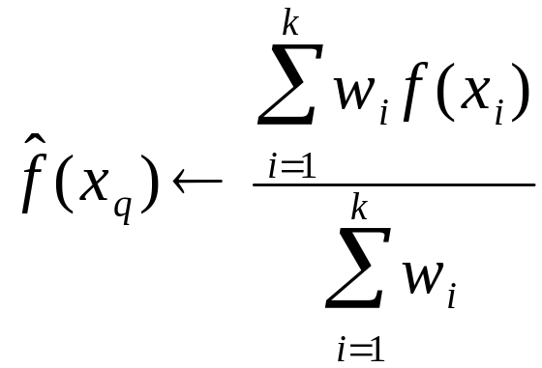
Distance Weighted
  For real valued functions

Slide 20
Curse of Dimensionality
Imagine instances described by 20 features (attributes) but only 3 are relevant to target function
Curse of dimensionality: nearest neighbor is easily misled when instance space is high-dimensional
Dominated by large number of irrelevant features
Possible solutions
Stretch j-th axis by weight z_{j}, where z₁,…,z_{n} chosen to minimize prediction error (weight different features differently)
Use cross-validation to automatically choose weights z₁,…,z_{n}
Note setting z_{j} to zero eliminates this dimension alltogether (feature subset selection)
PCA

Slide 21
When to Consider Nearest Neighbors
Instances map to points in R^{d}
Less than 20 features (attributes) per instance, typically normalized
Lots of training data
Advantages:
Training is very fast
Learn complex target functions
Do not loose information
Disadvantages:
Slow at query time
  Presorting and indexing training samples into search trees reduces time
Easily fooled by irrelevant features (attributes)

Slide 22
LVQ
(Learning Vector Quantization)
A nearest neighbor method, because the smallest distance of the unknown vector from a set of reference vectors is sought
However not all examples are stored as in kNN, but a a fixed number of reference vectors for each class v (for discrete function f) {v₁,......,v_{n}}
The value of the reference vectors is optimized during learning process

Slide 23
The supervised learning
  rewards correct classification
  puished incorrect classification
0 < α(t) < 1 is a monotonically decreasing scalar function

Slide 24
LVQ Learning (Supervised)
Initialization of reference vectors m; t=0;
do
{
chose x_{i} from the dataset
  m_{c} nearest reference vector according to d₂
  if classified correctly, the class v of m_{c} is equal to class of v of x_{i}
  if classified incorrectly, the class v of m_{c} is different to class of v of x_{i}
  t++;
}
until number of iterations t max_iterations

Slide 25
After learning the space R^{d} is partitioned by a Vornoi tessalation corresponding to m_{i}
The exist extension to the basic LVQ, called LVQ2, LVQ3

Slide 26
LVQ Classification
  Given a query instance x_{q} to be classified
  Let x_{answer} be the reference vector which is nearest to x_{q}, determine the corresponding v_{answer}

Slide 27
Kohonen Self Organizing Maps
Unsupervised learning
Labeling, supervised
Perform a topologically ordered mapping from high dimensional space onto two-dimensional space
The centroids (units) are arranged in a layer (two dimensional space), units physically near each other in a two-dimensional space respond to similar input

Slide 28
0 < α(t) < 1 is a monotonically decreasing scalar function
NE(t) is a neighborhood function is decreasing with time t
The topology of the map is defined by NE(t)
  The dimension of the map is smaller (equal) then the dimension of the data space
  Usually the dimension of a map is two
For tow dimensional map the number of the centroids should have a integer valued square root
  a good value to start is around 10² centroids

Slide 29
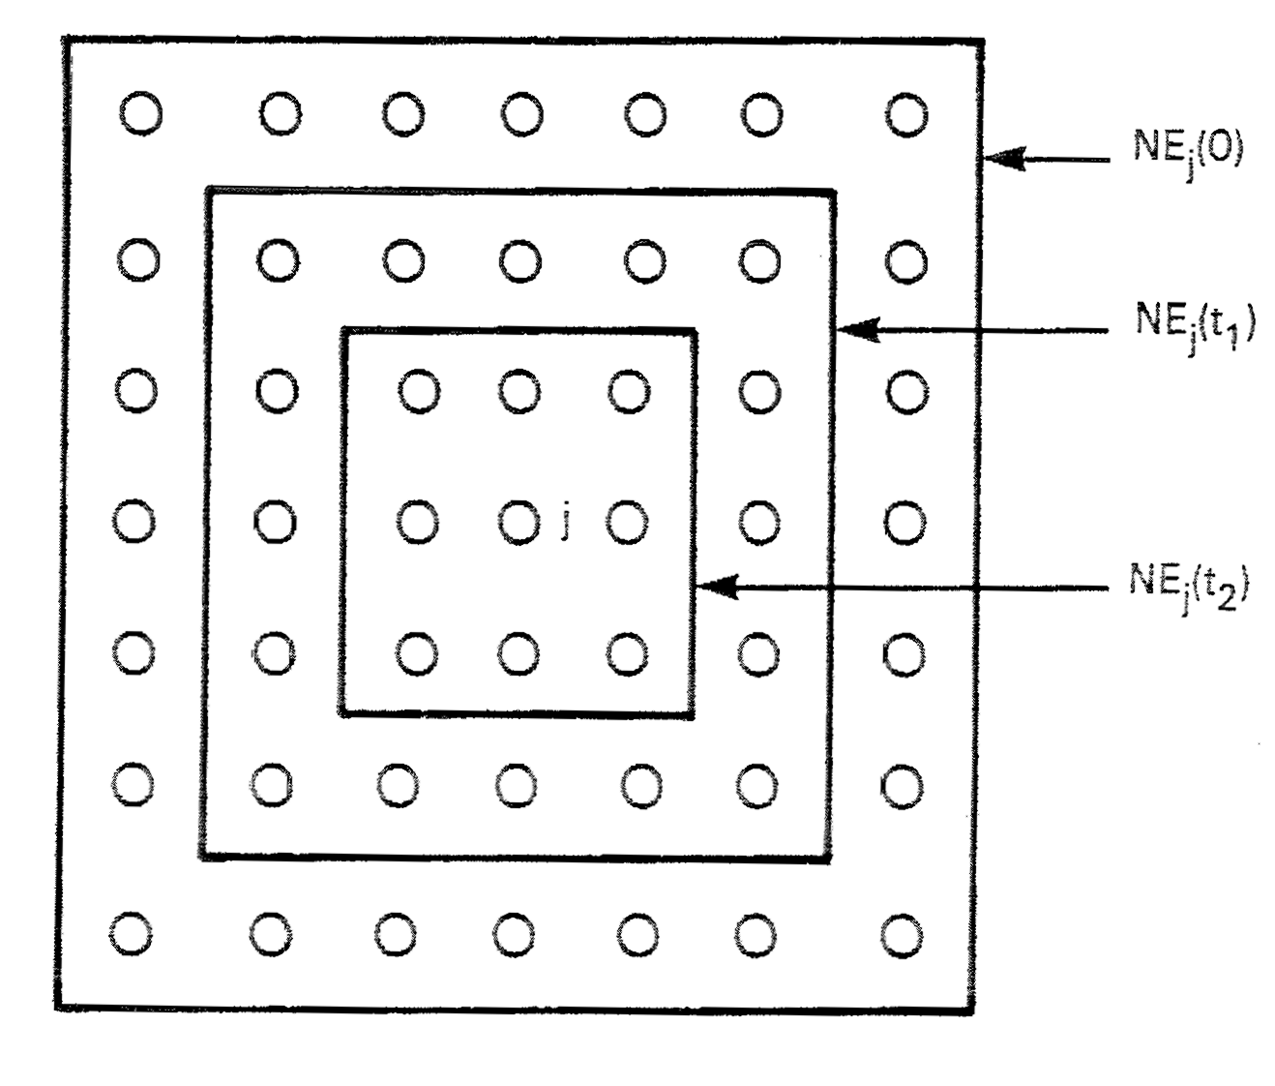
Neighborhood on the map

Slide 30
SOM Learning (Unsupervised)
Initialization of center vectors m; t=0;
do
{
chose x_{i} from the dataset
  m_{c} nearest reference vector according to d₂
  For all m_{r} near m_{c} on the map
  t++;
}
until number of iterations t max_iterations

Slide 31
Supervised labeling
The network can be labeled in two ways
(A) For each known class represented by a vector the closest centroid is searched and labeled accordingly
(B) For every centroid is is tested to which known class represented by a vector it is closest

Slide 32
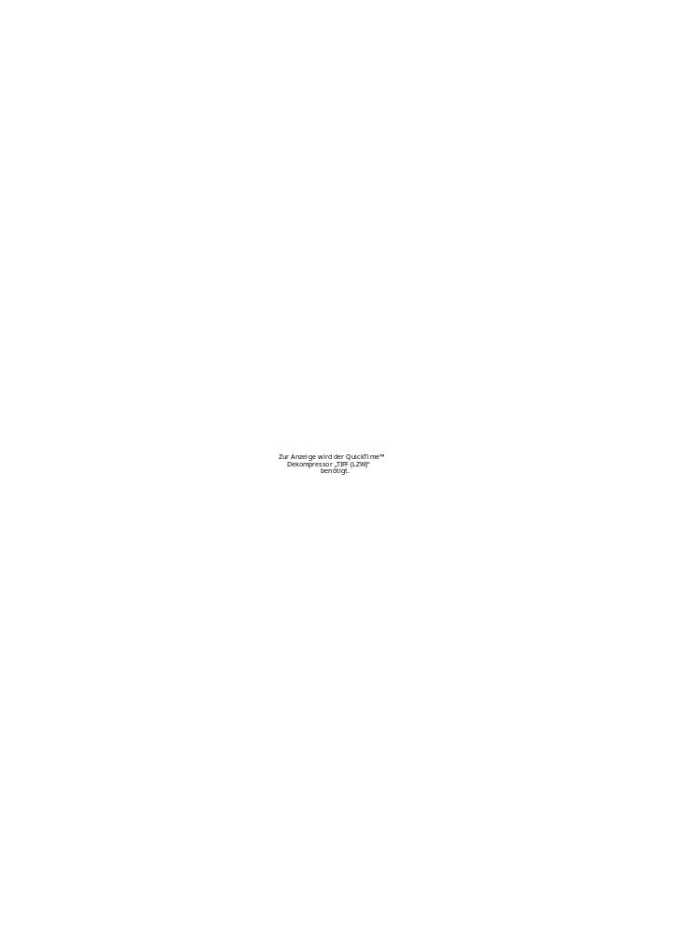
Example of labeling of 10 classes, 0,..,9
10*10 centroids
2-dim map

Slide 33

Animal
example

Slide 34
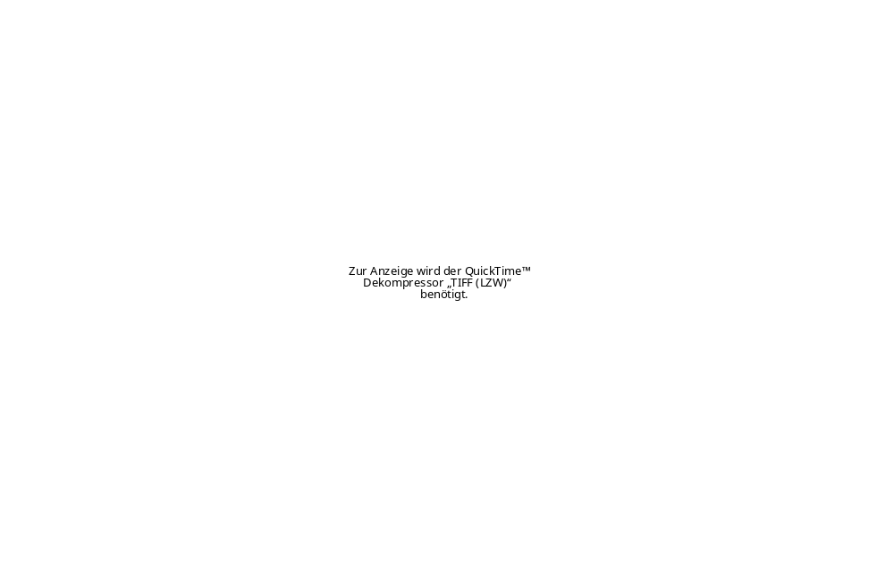
Poverty map of countries

Slide 35


Ordering process of 2 dim data random 2 dim points
2-dim map 1-dim map

Slide 36
Instance Based Learning
K-Nearest Neighbor Algorithm
(LVQ) Learning Vector Quantization
(SOM) Self Organizing Maps

Slide 37
Bayes Classification
Naive Bayes

